Slide 1
EIEIO MEISR APP
John Andrews
Stephen Bowles
Sungkyun Kim
Kevin Ziegler
Chase Feaster

Slide 2
Definition and Scope
Android App
Allow guardian to complete survey
Save an uncompleted survey
Display graph of scores
Simple, readable survey input interface
Website
Data Analyst
View and query data across all children
Update survey

Slide 3
Glossary
MEISR - An acronym for “Measure of Engagement, Independence, and Social Relationships”, a survey created by Dr. McWilliam of EIEIO for the purpose of evaluating child development in the categories named as they grow.
Guardian - A parent or primary caretaker of a child with a disability who is expected to be the primary operator of the app.
Data Analyst - A professional given access to the raw data collected by the MEISR app for the purpose of statistical analysis
Admin Site - The website for administrators to access/modify the database

Slide 4
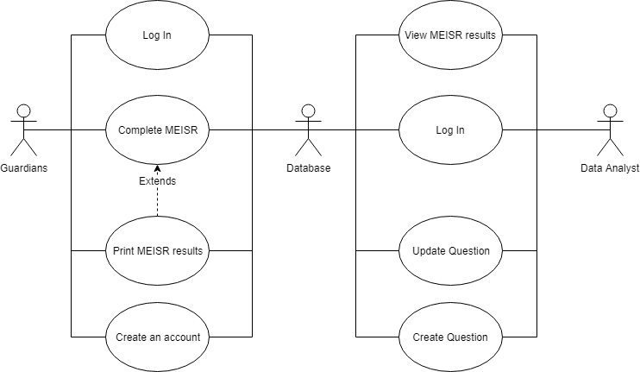
Use Case

Slide 5
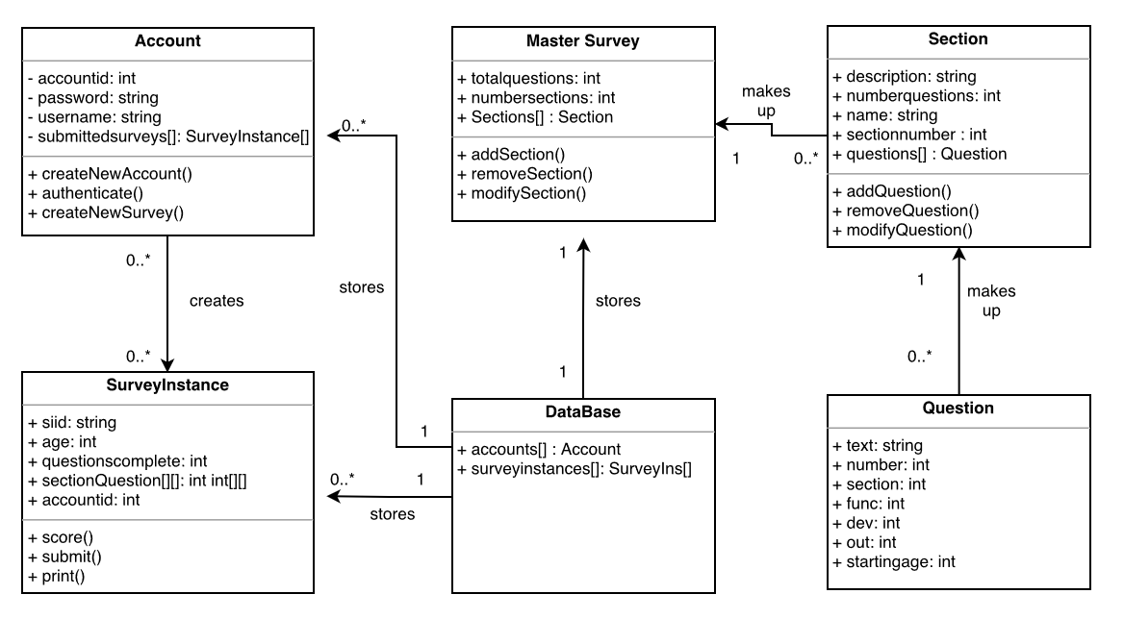
High-level class diagram

Slide 6
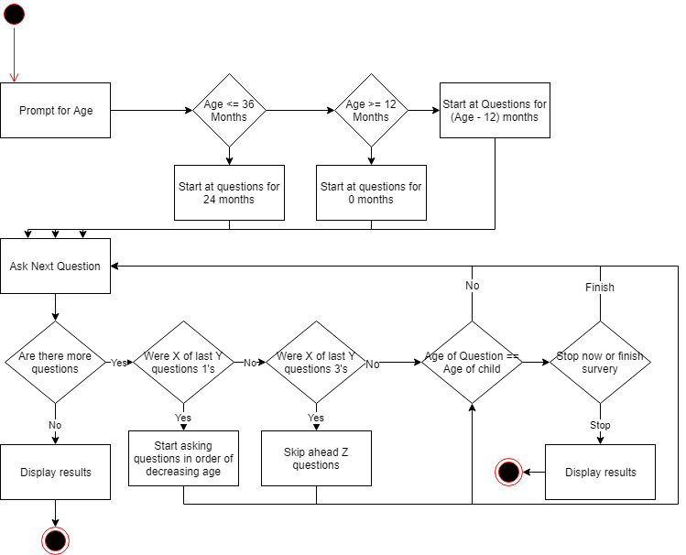
Complete MEISR Activity Diagram

Slide 9
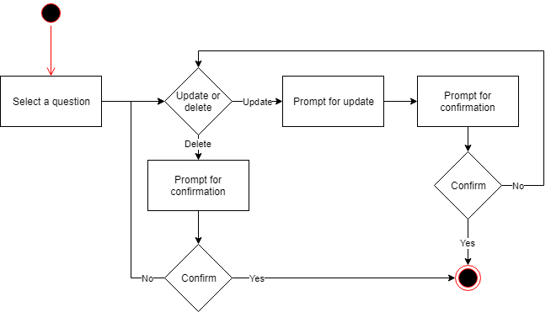
Update Question Activity Diagram

Slide 10
Features
FEATURE | PRIORITY
Security | Required
MEISR Survey (Android) | Required
Data Visualization (Android) | Required
Admin Site | Required
Cross Platform | Possible
Language Localization | Future

Slide 11
Potential Risks
Security risks
Must comply with FERPA and HIPPA
Licensing issues

Slide 12
Summary
Likely need to look up a graph display API
Competitors
MEISR is specialized

